Slide 1

Chapter 10
Error Detection
and
Correction
10.<number>
Copyright © The McGraw-Hill Companies, Inc. Permission required for reproduction or display.

Slide 2

Note
Data can be corrupted
during transmission.
Some applications require that
errors be detected and corrected.
10.<number>

Slide 3
10-1 INTRODUCTION
Let us first discuss some issues related, directly or indirectly, to error detection and correction.
Topics discussed in this section:
Types of Errors
Redundancy
Detection Versus Correction
Forward Error Correction Versus Retransmission
Modular Arithmetic
10.<number>

Slide 4
Note
In a single-bit error, only 1 bit in the data unit has changed.
10.<number>

Slide 5

Figure 10.1 Single-bit error
10.<number>

Slide 6
Note
A burst error means that 2 or more bits in the data unit have changed.
10.<number>

Slide 7

Figure 10.2 Burst error of length 8
10.<number>

Slide 8
Note
To detect or correct errors, we need to send extra (redundant) bits with data.
10.<number>

Slide 9

Figure 10.4 XORing of two single bits or two words
10.<number>

Slide 10
Example 1
Suppose the sender wants to send the word world. In ASCII the five characters are coded as
1110111 1101111 1110010 1101100 1100100
The following shows the actual bits sent
11101110 11011110 11100100 11011000 11001001

Slide 11
Example 2
Now suppose the word world in Example 1 is received by the receiver without being corrupted in transmission.
11101110 11011110 11100100 11011000 11001001
The receiver counts the 1s in each character and comes up with even numbers (6, 6, 4, 4, 4). The data are accepted.

Slide 12
Example 3
Now suppose the word world in Example 1 is corrupted during transmission.
11111110 11011110 11101100 11011000 11001001
The receiver counts the 1s in each character and comes up with even and odd numbers (7, 6, 5, 4, 4). The receiver knows that the data are corrupted, discards them, and asks for retransmission.

Slide 13

Figure 10.11 Two-dimensional parity-check code
10.<number>

Slide 14

Figure 10.11 Two-dimensional parity-check code
10.<number>

Slide 15

Figure 10.11 Two-dimensional parity-check code
10.<number>

Slide 16
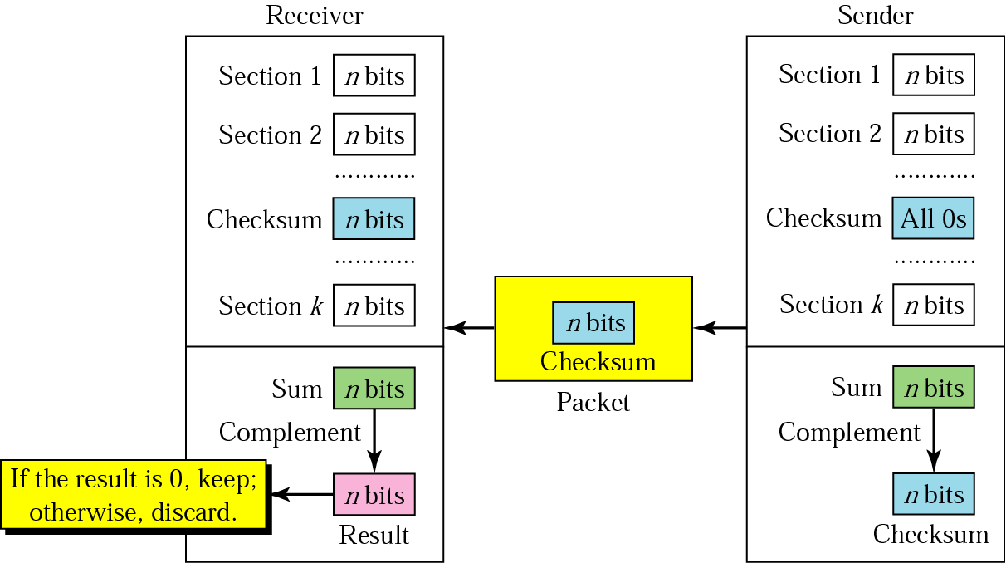
Checksum

Slide 17

Note:
The sender follows these steps:
The unit is divided into k sections, each of n bits.
All sections are added using one’s complement to get the sum.
The sum is complemented and becomes the checksum.
The checksum is sent with the data.

Slide 18
Note:
The receiver follows these steps:
The unit is divided into k sections, each of n bits.
All sections are added using one’s complement to get the sum.
The sum is complemented.
If the result is zero, the data are accepted: otherwise, rejected.

Slide 19
Example 7
Suppose the following block of 16 bits is to be sent using a checksum of 8 bits.
10101001 00111001
The numbers are added using one’s complement
10101001
00111001
------------
Sum 11100010
Checksum 00011101
The pattern sent is 10101001 00111001 00011101

Slide 20
Example 8
Now suppose the receiver receives the pattern sent in Example 7 and there is no error.
10101001 00111001 00011101
When the receiver adds the three sections, it will get all 1s, which, after complementing, is all 0s and shows that there is no error. 10101001
00111001
00011101
Sum 11111111
Complement 00000000 means that the pattern is OK.

Slide 21
10-2 BLOCK CODING
In block coding, we divide our message into blocks, each of k bits, called datawords. We add r redundant bits to each block to make the length n = k + r. The resulting n-bit blocks are called codewords.
Topics discussed in this section:
Error Detection
Error Correction
10.<number>

Slide 22

Table 10.1 A code for error detection (Example 10.2)
10.<number>

Slide 23
Note
An error-detecting code can detect
only the types of errors for which it is designed; other types of errors may remain undetected.
10.<number>

Slide 24
Note
A simple parity-check code is a
single-bit error-detecting
code in which
n = k + 1 with d_{min} = 2.
10.<number>

Slide 25

Table 10.3 Simple parity-check code C(5, 4)
10.<number>

Slide 26
Note
A simple parity-check code can detect an odd number of errors.
10.<number>

Slide 27
10-4 CYCLIC CODES
Cyclic codes are special linear block codes with one extra property. In a cyclic code, if a codeword is cyclically shifted (rotated), the result is another codeword.
Topics discussed in this section:
Cyclic Redundancy Check
10.<number>

Slide 28
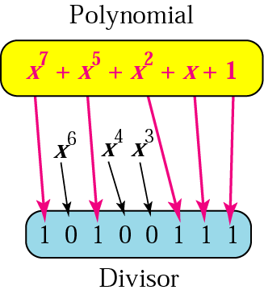
A polynomial representing a divisor

Slide 29
Standard Polynomials
Name | Polynomial | Application
CRC-8 | x⁸ + x² + x + 1 | ATM header
CRC-10 | x¹⁰ + x⁹ + x⁵ + x⁴ + x ² + 1 | ATM AAL
ITU-16 | x¹⁶ + x¹² + x⁵ + 1 | HDLC
ITU-32 | x³² + x²⁶ + x²³ + x²² + x¹⁶ + x¹² + x¹¹ + x¹⁰ + x⁸ + x⁷ + x⁵ + x⁴ + x² + x + 1 | LANs

Slide 30

Table 10.6 A CRC code with C(7, 4)
10.<number>

Slide 31

Figure 10.15 Division in CRC encoder
10.<number>

Slide 32

Figure 10.16 Division in the CRC decoder for two cases
10.<number>

